Slide 1
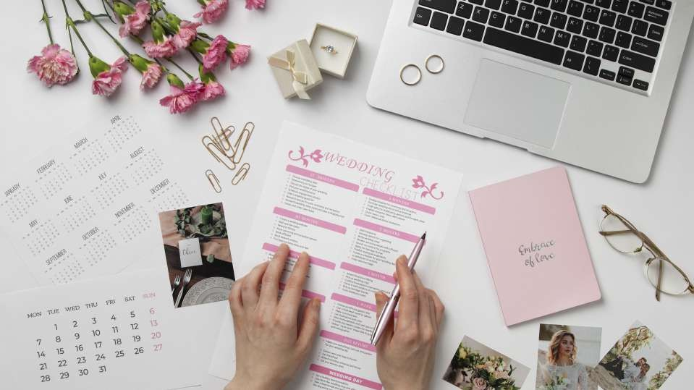
Elite Event Planner

Slide 2

Introduction
Welcome to the world of Elite Event Planner, where creativity meets precision.
In this presentation, we will unveil the key features and benefits of the Elite Event Planner website, designed to streamline and enhance your event planning experience.
We will discuss about problem statement, abstract and modifications .
Handling different types of Events. Providing different types of Services.
Inclusion of accessories for both bridal and groom.
Scope and Architecture
Others features of website.

Slide 3

Problem Statement 1:
Busy Lifestyles and Limited Time for Event Organization.
Modern individuals are immersed in busy daily routines, leaving them with insufficient time to plan and organize special events. The need for a solution arises to alleviate the burden of event organization for individuals with hectic schedules. Our platform aims to address this challenge by offering a convenient and efficient way for users to hire experienced event planners.

Slide 4
Problem Statement 2:
Lack of a Comprehensive Platform for Event Planners.
Event planners face a challenge in showcasing their skills, expertise, and past work in a centralized and effective manner. There is a need for a dedicated online platform that allows event planners to create detailed profiles featuring their portfolio, successful events, and client testimonials. Our website seeks to bridge this gap by providing event planners with a comprehensive platform to highlight their unique strengths and attract potential clients.

Slide 5

Abstract
We are providing a platform where they could hire’s an event planner for organizing their events. An event planner is a professional who is specialize in this field and responsible for organizing and coordinating various types of events, such as weddings, corporate meetings, conferences, festivals, parties, ceremonies and other special occasions. Their main objective is to ensure that the event runs smoothly on time, and within budget, while also meeting the specific needs and expectations of the clients and attendees.
Our website seeks to bridge this gap by providing event planners with a comprehensive platform to highlight their unique strengths and attract potential clients.

Slide 6

Modifications
Innovative Events Expert
This website drawback is that they are not covering all events and not providing features and sample designs of events.
Wedding Planner Group
This websites drawback is that they are just covering the area of wedding planning.
Tulips Events
This website drawback is that they are not covering all events and not providing complete details of its and not providing component of accessories.

Slide 7
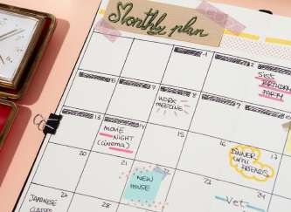
modi...
Mostly different websites covering the mostly individual areas and if they are working on all types of events then they are not providing all types of functionalities, services and accessories. So We are covering these issues:
Covering All Events
Description of event individually Providing Maximum Services Helping in Accessories(Bridal And Groom)
Hiring Event Planners and others team workers

Slide 8
Wedding
Corporate
Social
Cultural

Slide 9

Wedding Events
Bridal Showers Engagement Parties Bachelor Parties Bachelorette Parties Rehearsal Dinners Ceremony and Reception Vow Renewals Destination Wedding

Slide 10
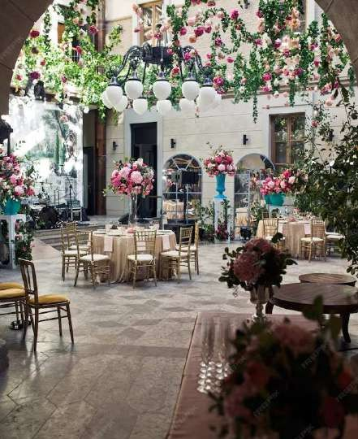
Wedding Services
Ceremony and Reception Coordination Rehearsal Dinner Coordination Wedding Day Timeline
Rentals and Vendor Coordination Floor plan Design
Wedding Concept and Design Budget Management
Security and Staffing Tenting
Transportation and Parking

Slide 11

Corporate Events
Conferences Seminars Board Meetings Workshops Charity Events
Team-building events
Product Launches Networking Events

Slide 12

Corporate Services
On-site Coordination and Management Meeting Planning
Brand Integration
Rentals and Vendor Coordination Floor plan Design
Budget Management Staging
Security and Staffing Entertainment
Transportation and Parking

Slide 13

Social Gathering Events
Birthdays
Personal Milestones
Baby Shower Gender Reveal Family Reunions School and College Reunions
Holiday Parties Seasonal Events
Convocations

Slide 14
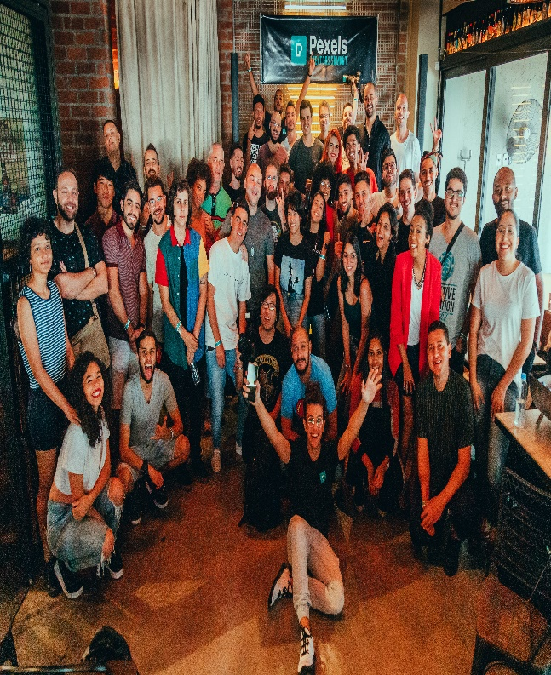
Social Gathering Services
On-site Coordination and Management Event Planning and Design
Event Rentals Vendor Coordination Floor plan Design
Budget Management Staging
Security and Staffing Entertainment Transportation and Parking

Slide 15
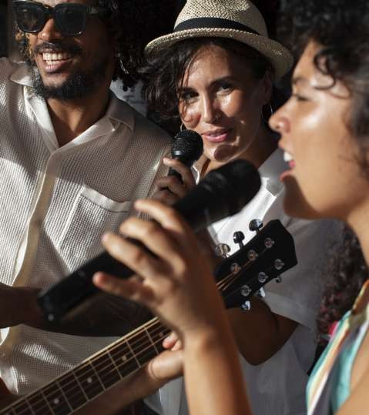
Cultural Events
Festive Events
Country-based Cultural Events
Dance and Music Events Sports Events
Prose and Poetry Events
Pottery and Ceramics Wood Working
Art Workshops

Slide 16

Cultural Services
On-site Coordination and Management Decoration
Vendor Coordination Floor plan Design Budget Management Staging
Security and Staffing Entertainment Transportation and Parking

Slide 17






Services
Catering Decoration Invitations Venue Selection
Photography & Videography Security
Entertainment Transportation etc...

Slide 18

Accessories (Both for Bridal and Groom)
Clothes Shoes Jewlery cakes
Makeup Products Purses
Watches Mehndi Items etc...

Slide 19

Scope
The scope of the event planners is quite broad.“Elite Event Planner” project could be used publicly. Any person which wants to organize any type of event, he can hire event planner anytime.
Corporate clients
Non-profit organizations Social clients Government agencies Educational institutions

Slide 20
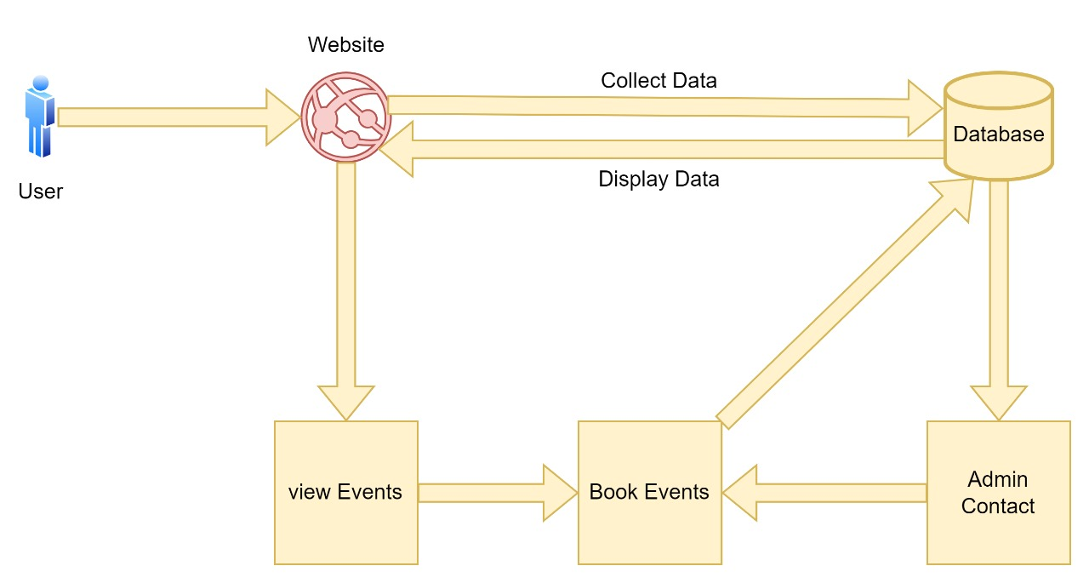
Architecture

Slide 21


Languages & Tools
Frontend and Backend Languages : Html and CSS
JavaScript Bootstrap Php
My SQL
Here Are Tools list :
VS Code
Adobe Photoshop MS Project XAMPP Server StarUML
Canva

Slide 22

Others Features Of Website
Carrier oppourtunities Team Members Portfolio Blogs
Gallery Testimonials Contact Us

Slide 23
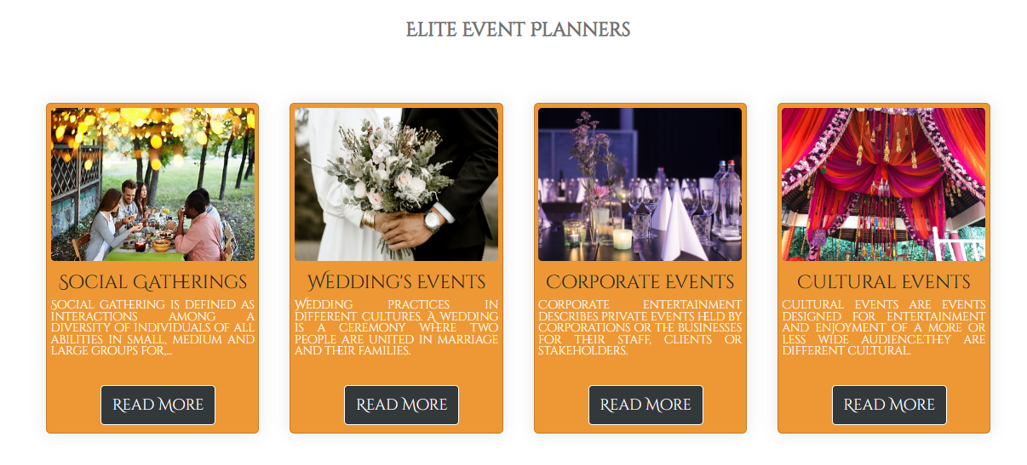
Blogs

Slide 24
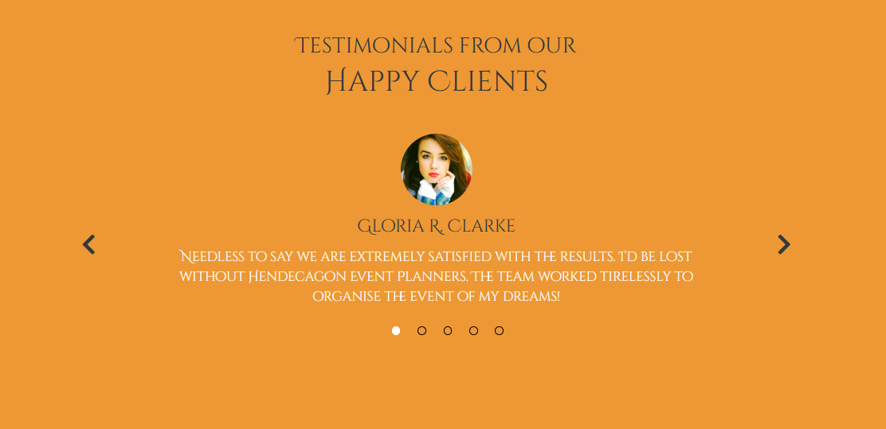
Testimonials

Slide 25
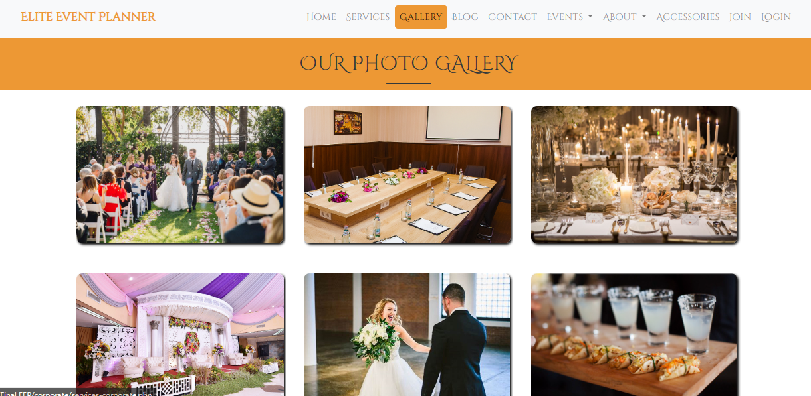
Gallery

Slide 26
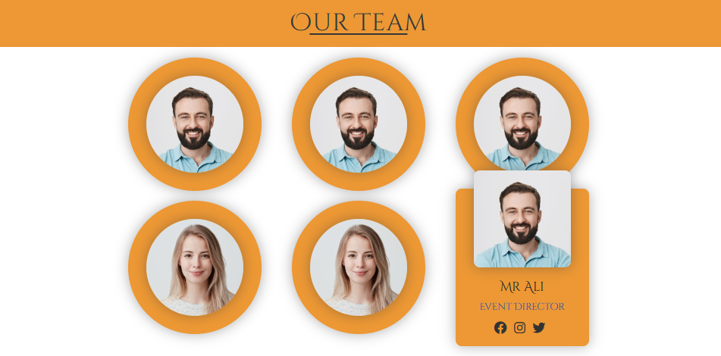
Team Members Portfolio

Slide 27
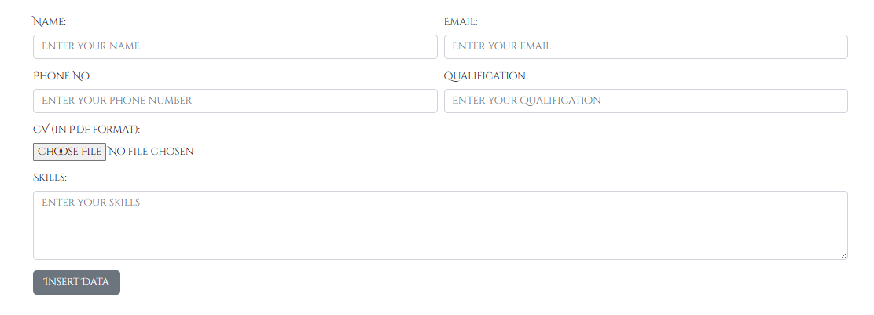
Carrier opportunities

Slide 28
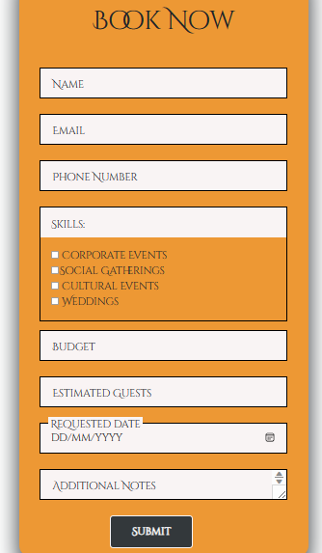
Booking Form

Slide 29
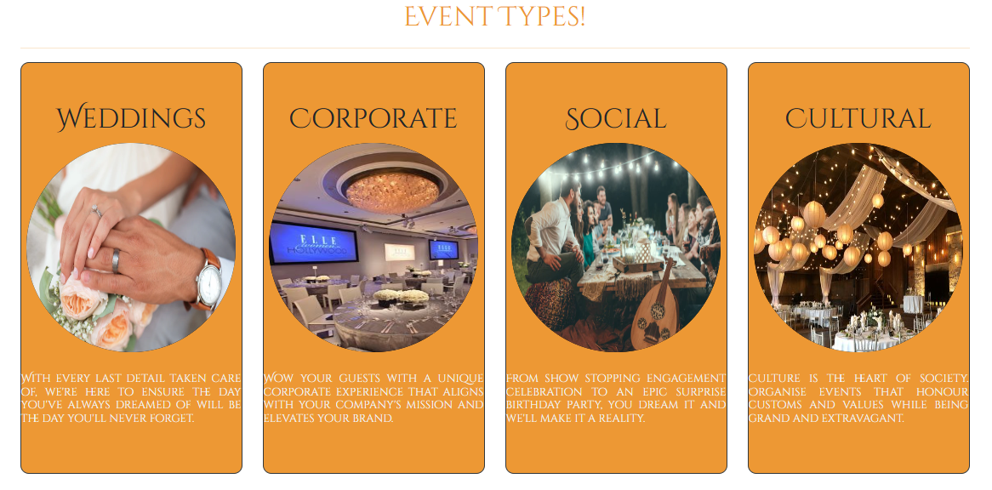
Event Types

Slide 30

Thank You!

